Slide 1
CHAPTER 2
INTEREST RATES

Slide 2
Chapter Outline
1. Measuring interest rates
2. The behavior of interest rates
3. Risk structure of interest rates
4. Term structure of interest rates

Slide 3
Measuring interest rates (Ref: Mishkin, Financial Markets + Institutions Ch.3)
How YTM is measured on credit market instruments?
A bond’s interest rate does not necessarily indicate how good an investment a bond is.
The distinction between interest rates and returns
The distinction between real and nominal interest rates.

Slide 4
Interpretation of Interest Rate
Current consumption is preferred to future consumption. A dollar on hand is preferred to a dollar received in the future.
To induce people to invest their money, investments must offer additional benefit (i.e., risk free rate).
Investments are risky. Minor additional benefit is not enough. There must be a risk premium.
Notes:
(Refer: CFAI 2012 Level 1 Volume 1 SS2)

Slide 5
Interpretation of Interest Rate
Interest Rate [or (Required) Rate of Return]
= Risk Free Rate
+ Risk Premium
+ Inflation Premium
Risk free rate: Preference of individuals for cash on hand versus future income.
Notes:
(Refer: CFAI 2012 Level 1 Volume 1 SS2)

Slide 6
Interpretation of Interest Rate
Each individual requires different rate of returns on the same assets, based on their level of risk tolerance. Highly risk-adverse investors required higher returns.
However, many financial assets are traded in the markets. Their prices (and rates of return) are set at the equilibrium of demands and supplies or at arbitrage-free prices. The rates of return set by the market is called the market rates of return.
Notes:
(Refer: CFAI 2012 Level 1 Volume 1 SS2, Miskin 7th Chapter 3)

Slide 7
Interpretation of Present Value
Different debt instruments have very different streams of cash payments to the holder known as cash flows (CF).
All else being equal, debt instruments are evaluated against one another based on the amount of each cash flow and the timing of each cash flow.
This evaluation, where the analysis of the amount and timing of a debt instrument’s cash flows lead to its yield to maturity or interest rate, is called present value analysis.

Slide 8
Present Value Concept: Simple Loan Terms
Loan Principal: the amount of funds the lender provides to the borrower.
Maturity Date: the date the loan must be repaid; the Loan Term is from initiation to maturity date.
Interest Payment: the cash amount that the borrower must pay the lender for the use of the loan principal.
Simple Interest Rate: the interest payment divided by the loan principal; the percentage of principal that must be paid as interest to the lender. Convention is to express on an annual basis, irrespective of the loan term.

Slide 9
Example-Simple Interest Rate
A simple loan of $100 requires the borrower to repay $100 principal plus $10 interest one year from now. For this simple loan, the interest payment expressed as a percentage of the principal is a sensible way of measuring the interest rate.
→ Simple Interest Rate = 10%

Slide 10
Interest rate and time value of money
The future value of PV after n years:
Interest is paid once per year (annual R)
Interest is paid m times (frequency
of interest payment) per year
R : discrete /periodic interest rate
Interest is paid continuously:
m ~ infinity (cont. compounded interest rate)

Slide 11
Problem 1
You must pay a creditors $6.000 one year from now, $5000 two years from now, $4000 three years from now, $2000 four years from now and a final $1000 five years from now. You would like to restructure the loan into five equal annual payments due at the end of each year. If the agreed interest rate is 6% compounded annually, what is the payment?

Slide 12
Problem 2
You have just inherited an office building. You expect the annual rental income (net of maintenance and other cost) for the building to be $100,000 for the next year and to increase at 5% per year indefinitely. A expanding internet company offers to rent the building at a fixed annual rent for 5 years. After year 5, you could re-negotiate or rent the building to another tenant. What is the minimum acceptable fixed rental payments for this five-year agreement? Use a discount rate of 12%.

Slide 13
Problem 3
Your favorite grandfather wants to make a single deposit today in an account from which you will withdraw $10.000 one year from today; $20.000 two years from today; and $30.000 per year forever thereafter, with your first $30.000 withdrawal three years from today. The account will earn interest at rate of 10% per year compounded annually, forever.
Assuming that you will indeed live forever, how much your grandfather deposit in the account today?
Suppose your grandfather does not expect you to live forever. Instead, he wants to deposit enough today to enable you to make just 40 annual withdrawals of $30.000, starting three years from today, in addition to the $10.000 withdrawal one year from today and the $20.000 withdrawal two years from today. How large must his single deposit today be?

Slide 14
Yield to Maturity: Loans
Yield to maturity = interest rate that equates today's value with present value of all future payments.
Financial economists consider YTM the most accurate measure of interest rate.

Slide 15
Yield to Maturity
For a simple loan: PV = FV/(1+i)
For a fixed payment loan
For a coupon bond:
For a semi-annual coupon bond

Slide 16
Effective annual rate:
Interest rates on loans and saving accounts are usually stated in the form of an annual percentage rate (APR) with a certain frequency of compounding.
Ex: A bank quotes an interest of 8% per annum (called simple annual rate) with quarterly compounding. What is the effective annual rate (equivalent annual interest rate)?

Slide 17
Problem 3
Which security has a higher effective annual interest rate?
(a) A three-month T-bill selling at $97,645 with face value of $100, 000.
(b) A coupon bond selling at par and paying a 10% coupon semi-annually.

Slide 18
Continuous compounding rate
Ex: A bank quotes an interest of 8% per annum (called simple annual rate) with quarterly compounding. What is the equivalent rate with continuous compounding?

Slide 19
Global perspective- Negative T-bill Rates
In November 1998, rates on Japanese 6-month Treasury bills were negative! Investors were willing to pay more than they would receive in the future.
Why? no investment opportunities, deflation, do tính chất của nền kinh tế mỗi nước
(Ref: Mishkin & Eakins, Financial Markets + Institutions, Ch3)

Slide 20
Distinction Between Real and Nominal Interest Rates
Real interest rate
Interest rate that is adjusted for expected changes in the price level
Real interest rate more accurately reflects true cost of borrowing
When the real rate is low, there are greater incentives to borrow and less to lend

Slide 21
U.S. Real and Nominal Interest Rates
Sample of current rates and indexes
http://www.martincapital.com/charts.htm

Slide 22
Distinction Between Interest Rates and Returns
Rate of Return: we can decompose returns into two pieces:
where = current yield, and
= capital gains.

Slide 23
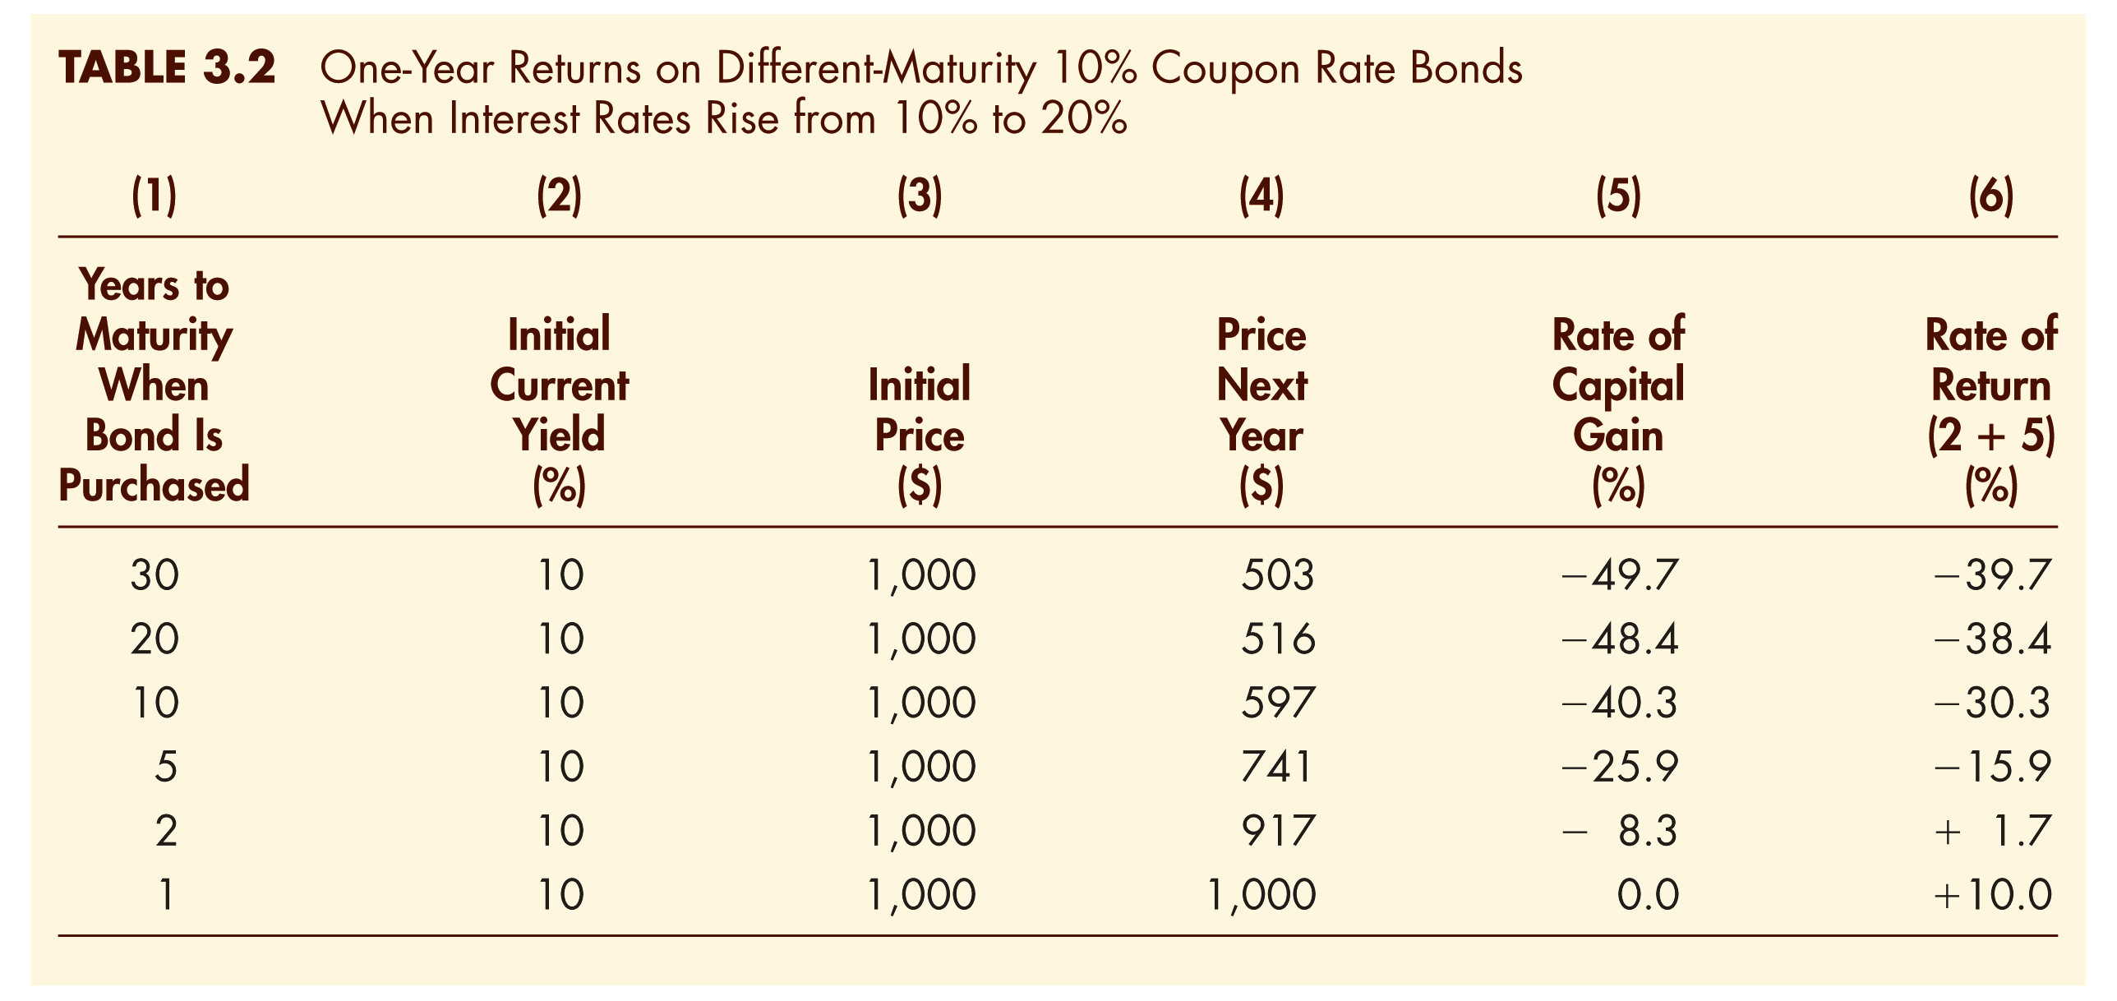
Key Facts about the Relationship Between Rates and Returns

Slide 24
Maturity and the Volatility of Bond Returns
Key findings
Only bond whose return = yield is one with maturity = holding period
For bonds with maturity > holding period, i ↑ P ↓ implying capital loss
Longer is maturity, greater is price change associated with interest rate change
Longer is maturity, more return changes with change in interest rate
Bond with high initial interest rate can still have negative return if i ↑

Slide 25
Some conclusions
Prices and returns more volatile for long-term bonds because have higher interest-rate risk
No interest-rate risk for only bond whose maturity equals holding period

Slide 26
Problem 4
According to Table 3.2, a 10% coupon bond with 10 years to maturity, will suffer a 40.3% capital loss if interest rates rise from 10% to 20%.
Suppose you purchase a 10 year Zero coupon bond with a 10% YTM. In other words, you can buy a $1000 face value bond at a discount so that it provides a 10% YTM.
What would your capital loss be on the Zero-coupon bond if interest rates (YTM) rise to 20% next year? Why is the capital loss different than the loss on the 10% coupon bond?

Slide 27
Current Yield
Current yield (CY) is just an approximation for YTM – easier to calculate. However, we should be aware of its properties:
If a bond’s price is near par and has a long maturity, then CY is a good approximation.
A change in the current yield always signals change in same direction as yield to maturity

Slide 28
Yield on a Discount Basis
One-Year Bill (P = $900, F = $1000)
Two Characteristics
Understates yield to maturity; longer the maturity, greater is understatement
Change in discount yield always signals change in same direction as yield to maturity

Slide 29
2. The behavior of interest rates
Determinants of Asset Demand
Supply and Demand in the Bond Market
Changes in Equilibrium Interest Rates
(Ref: Mishkin & Eakins, Financial Markets + Institutions, Ch.4)

Slide 30
EXAMPLE 1: Expected Return
What is the expected return on an Exxon-Mobil bond if the return is 12% two-thirds of the time and 8% one-third of the time?
Solution
The expected return is 10.68%.
R^{e} = p₁R₁ + p₂R₂
where
p₁ = probability of occurrence of return 1 = 2/3 = .67
R₁ = return in state 1 = 12% = 0.12
p₂ = probability of occurrence return 2 = 1/3 = .33
R₂ = return in state 2 = 8% = 0.08
Thus
R^{e} = (.67)(0.12) + (.33)(0.08) = 0.1068 = 10.68%

Slide 31
The average of historical returns: a measure of expected return:
Expected return based on a specific asset pricing model, such as CAPM

Slide 32
EXAMPLE 2: Standard Deviation (a)
Consider the following two companies and their forecasted returns for the upcoming year:

Slide 33
EXAMPLE 2: Standard Deviation (b)
What is the standard deviation of the returns on the Fly-by-Night Airlines stock and Feet-on-the-Ground Bus Company, with the return outcomes and probabilities described above? Of these two stocks, which is riskier?

Slide 34
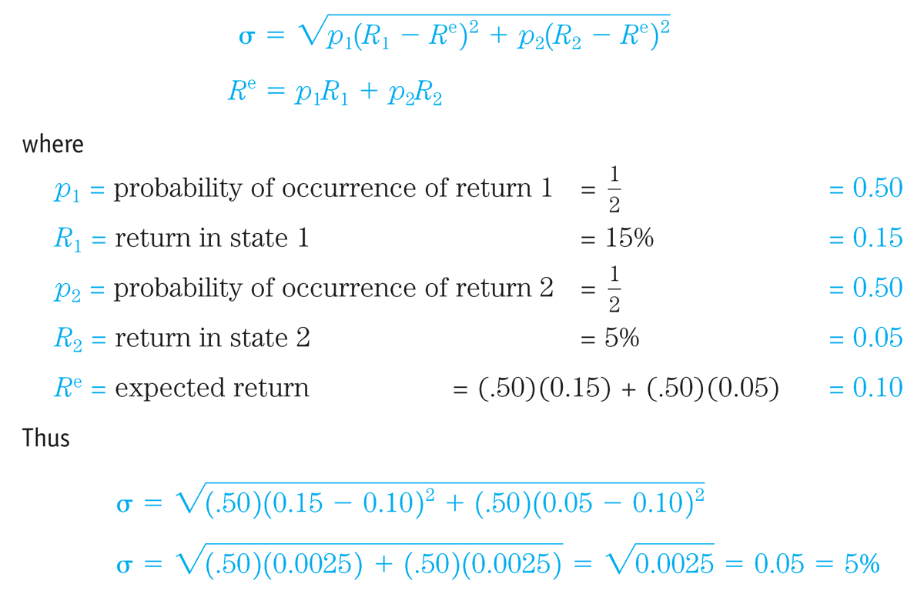
EXAMPLE 2: Standard Deviation (c)
Solution
Fly-by-Night Airlines has a standard deviation of returns of 5%.

Slide 35
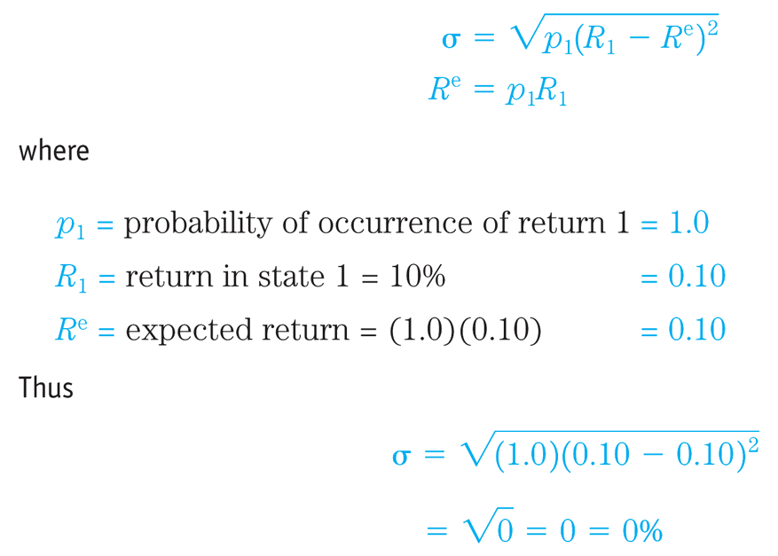
EXAMPLE 2: Standard Deviation (d)
Feet-on-the-Ground Bus Company has a standard deviation of returns of 0%.

Slide 36
EXAMPLE 2: Standard Deviation (e)
Fly-by-Night Airlines has a standard deviation of returns of 5%; Feet-on-the-Ground Bus Company has a standard deviation of returns of 0%
Clearly, Fly-by-Night Airlines is a riskier stock because its standard deviation of returns of 5% is higher than the zero standard deviation of returns for Feet-on-the-Ground Bus Company, which has a certain return
A risk-averse person prefers stock in the Feet-on-the-Ground (the sure thing) to Fly-by-Night stock (the riskier asset), even though the stocks have the same expected return, 10%. By contrast, a person who prefers risk is a risk preferrer or risk lover. We assume people are risk-averse, especially in their financial decisions

Slide 37
Standard deviation- general equation
It’s rarely feasible to specify the full distribution of possible returns and expected variance.
Must know all possible outcomes & associated probabilities
Instead, analysts usually gather historical data and use these to generate expected return and variance

Slide 38
Uncorrected sample standard deviation/ standard deviation of the sample
Corrected sample standard deviation

Slide 39
Two Assets With Same Expected Return But Different (Continuous) Probability Distributions
Stock 1
Probability Density
Stock 2
0 5 6 7 8 9 10 11 12 13 14 15
Return %
Notes:
Clearly, Stock 2 is a risky stock!

Slide 40
Determinants of Asset Demand (2)
The quantity demanded of an asset differs by factor.
Wealth: Holding everything else constant, an increase in wealth raises the quantity demanded of an asset
Expected return: An increase in an asset’s expected return relative to that of an alternative asset, holding everything else unchanged, raises the quantity demanded of the asset
Risk: Holding everything else constant, if an asset’s risk rises relative to that of alternative assets, its quantity demanded will fall
Liquidity: The more liquid an asset is relative to alternative assets, holding everything else unchanged, the more desirable it is, and the greater will be the quantity demanded

Slide 41
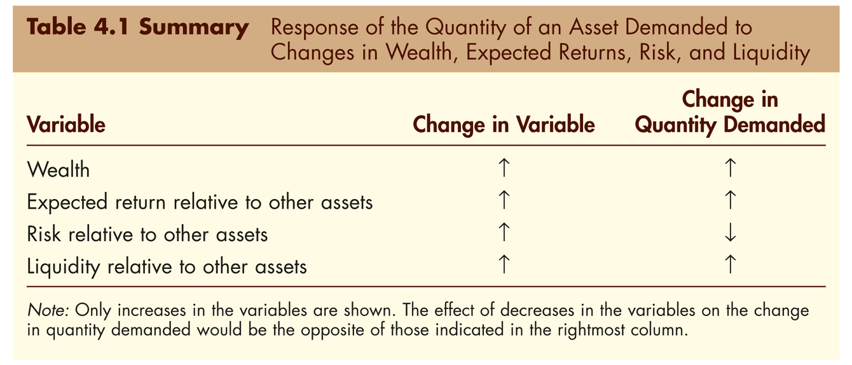
Determinants of Asset Demand (3)

Slide 42
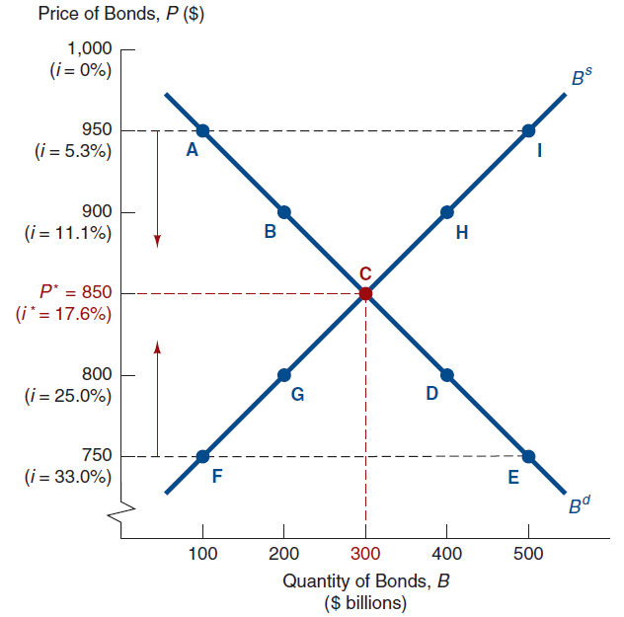
Loanable Funds Framework
Let’s consider a one-year discount bond with a face value of $1,000. The return is, then, the bond’s yield to maturity.
Interest rate is determined by bond supply and demand equilibrium.
(Refer: Mishkin 7th Chapter 4, Madura 9th Chapter 1)

Slide 43
How Factors Shift the Demand Curve
Wealth/saving
Economy ↑, wealth ↑
B^{d} ↑, B^{d} shifts out to right
OR
Economy ↓, wealth ↓
B^{d} shifts out to left

Slide 44
How Factors Shift the Demand Curve
2. Expected Returns on bonds
i ↓ in future, R^{e} for long-term bonds ↑
B^{d} shifts out to right
OR
π^{e} ↓, relative R^{e} ↑
B^{d} shifts out to right

Slide 45
How Factors Shift the Demand Curve
…and Expected Returns on other assets
ER on other asset (stock) ↑
R^{e} for long-term bonds ↓
B^{d} shifts out to left
These are closely tied to expected interest rate and expected inflation

Slide 46
How Factors Shift the Demand Curve
Risk
Risk of bonds ↓, B^{d} ↑
B^{d} shifts out to right
OR
Risk of other assets ↑, B^{d} ↑
B^{d} shifts out to right

Slide 47
How Factors Shift the Demand Curve
4. Liquidity
Liquidity of bonds ↑, B^{d} ↑
B^{d} shifts out to right
OR
Liquidity of other assets ↓, B^{d} ↑
B^{d} shifts out to right

Slide 48
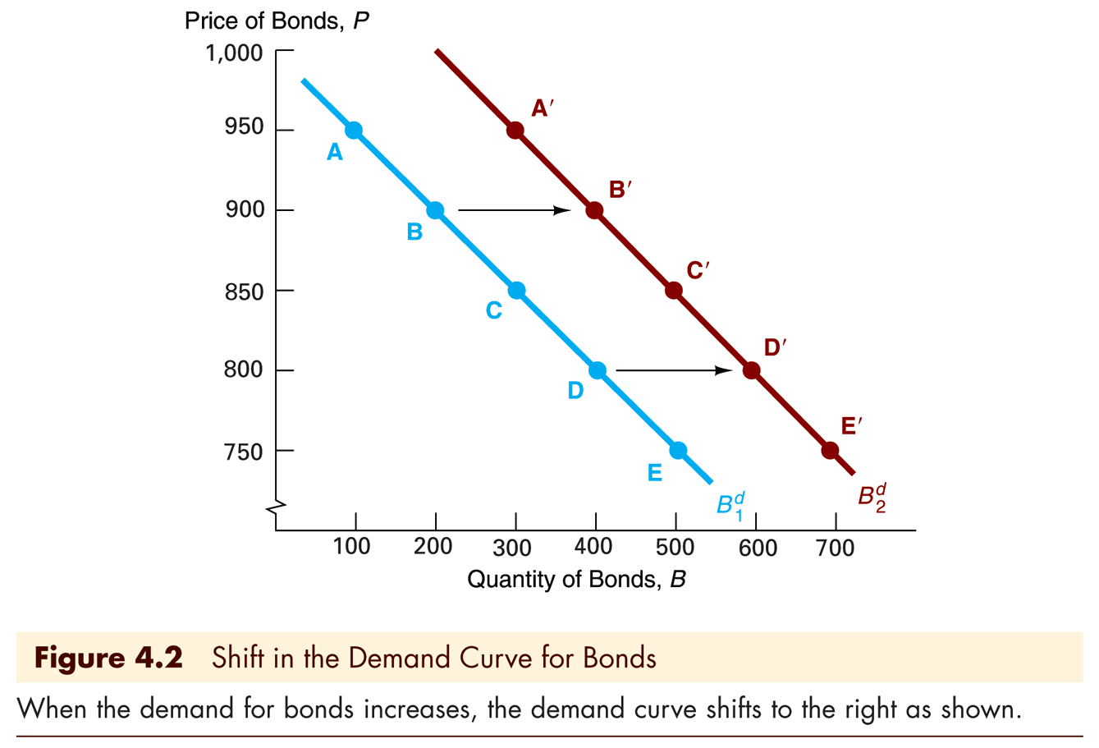
Shifts in the Demand Curve

Slide 49
Summary of Shifts in the Demand for Bonds
Wealth: in a business cycle expansion with growing wealth, the demand for bonds rises, conversely, in a recession, when income and wealth are falling, the demand for bonds falls
Expected returns: higher expected interest rates in the future decrease the demand for long-term bonds, conversely, lower expected interest rates in the future increase the demand for long-term bonds

Slide 50
Summary of Shifts in the Demand for Bonds (2)
Risk: an increase in the riskiness of bonds causes the demand for bonds to fall, conversely, an increase in the riskiness of alternative assets (like stocks) causes the demand for bonds to rise
Liquidity: increased liquidity of the bond market results in an increased demand for bonds, conversely, increased liquidity of alternative asset markets (like the stock market) lowers the demand for bonds

Slide 51
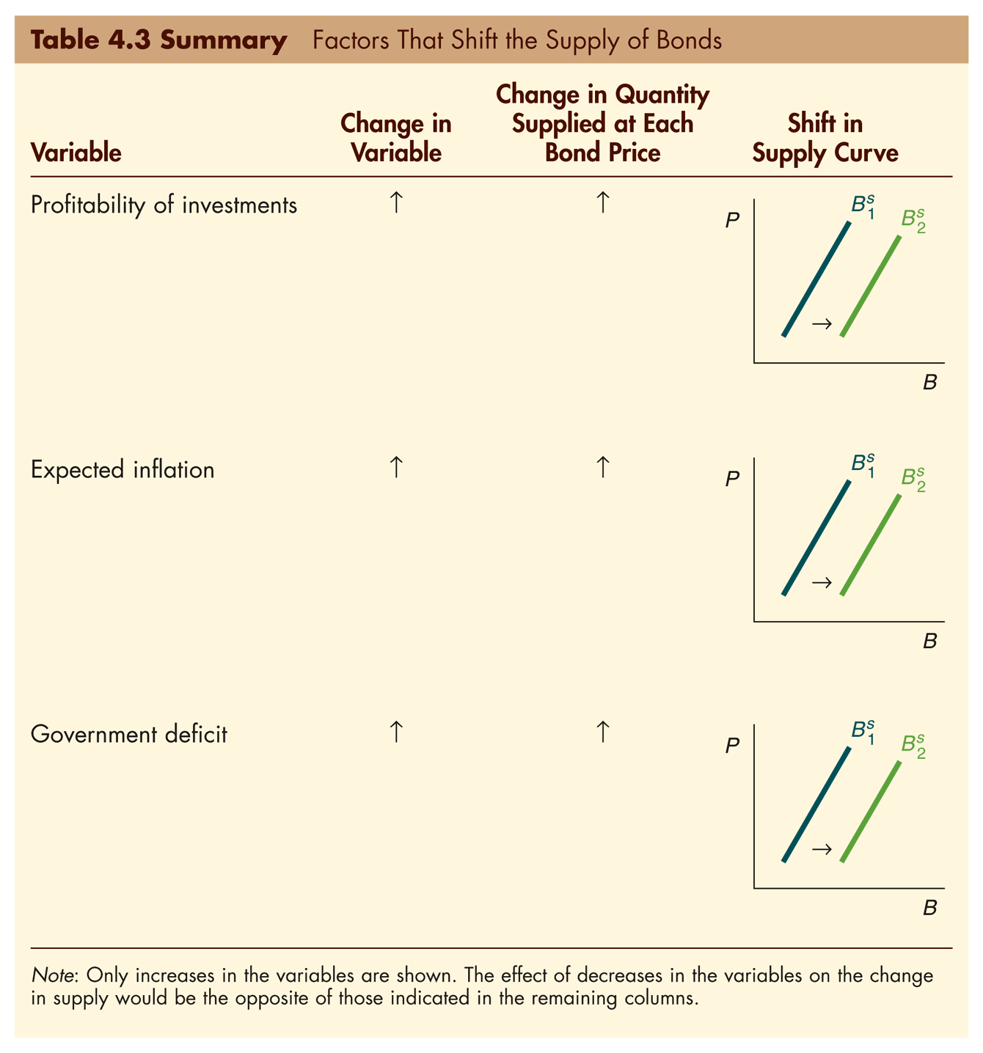
Factors That Shift Supply Curve
We now turn to the supply curve. We summarize the effects in this table:

Slide 52
Shifts in the Supply Curve
Profitability of Investment Opportunities
Business cycle expansion,
investment opportunities ↑, B^{s} ↑,
Bs shifts out to right

Slide 53
Shifts in the Supply Curve
2. Expected Inflation
π^{e} ↑, B^{s} ↑
B^{s} shifts out to right
3. Government Activities
Deficits ↑, B^{s} ↑
B^{s} shifts out to right

Slide 54
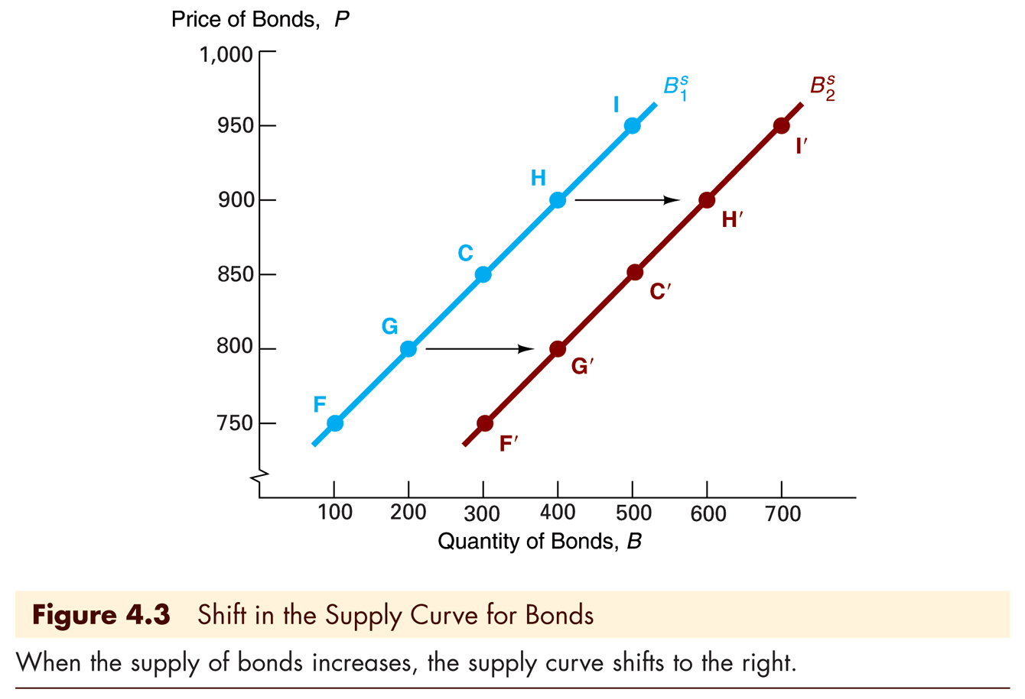
Shifts in the Supply Curve

Slide 55
Summary of Shifts in the Supply of Bonds
Expected Profitability of Investment Opportunities: in a business cycle expansion, the supply of bonds increases, conversely, in a recession, when there are far fewer expected profitable investment opportunities, the supply of bonds falls
Expected Inflation: an increase in expected inflation causes the supply of bonds to increase
Government Activities: higher government deficits increase the supply of bonds, conversely, government surpluses decrease the supply of bonds

Slide 56
Case: Fisher Effect
Recall that rates are composed of several components: a real rate, an inflation premium, and various risk premiums.
What if there is only a change in expected inflation?

Slide 57
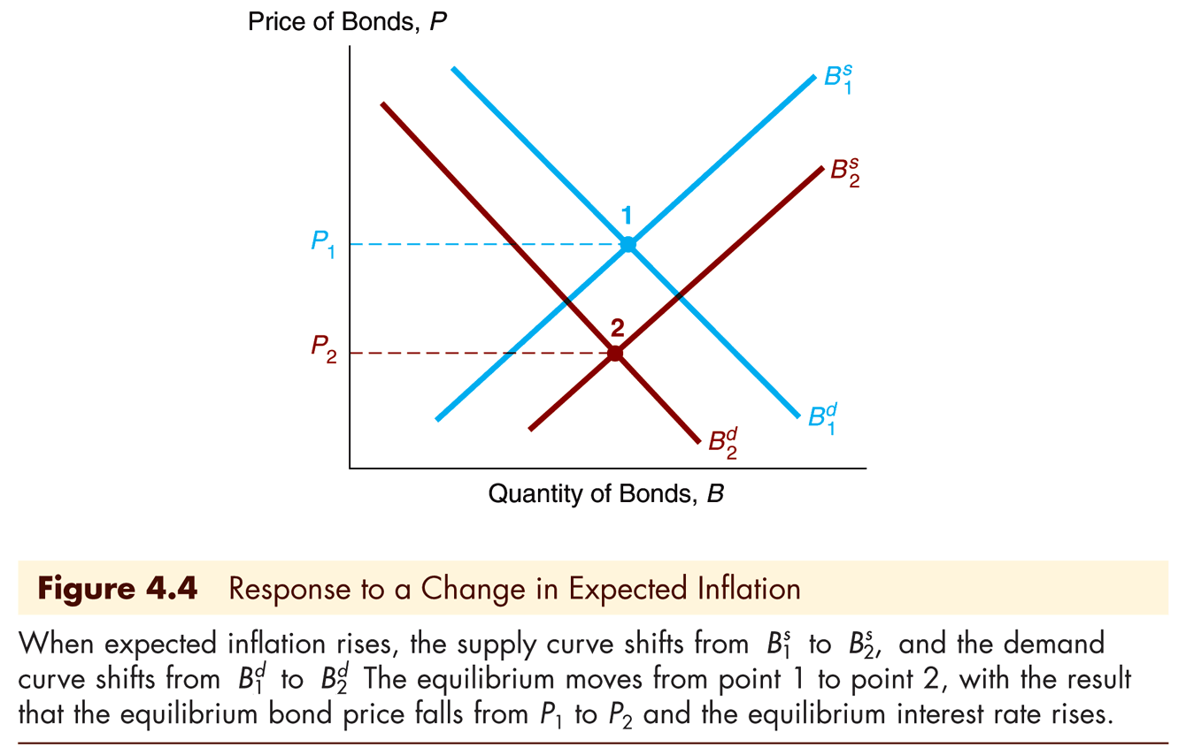
Changes in π^{e}: The Fisher Effect
If π^{e} ↑
Relative R^{e} ↓, B^{d} shifts in to left
B^{s} ↑, B^{s} shifts out to right
P ↓, i ↑

Slide 58
Evidence on the Fisher Effect in the United States

Slide 59
Summary of the Fisher Effect
If expected inflation rises from 5% to 10%, the expected return on bonds relative to real assets falls and, as a result, the demand for bonds falls
The rise in expected inflation also means that the real cost of borrowing has declined, causing the quantity of bonds supplied to increase
When the demand for bonds falls and the quantity of bonds supplied increases, the equilibrium bond price falls
Since the bond price is negatively related to the interest rate, this means that the interest rate will rise

Slide 60
Case: Business Cycle Expansion
Another good thing to examine is an expansionary business cycle. Here, the amount of goods and services for the country is increasing, so national income is increasing.
What is the expected effect on interest rates?

Slide 61
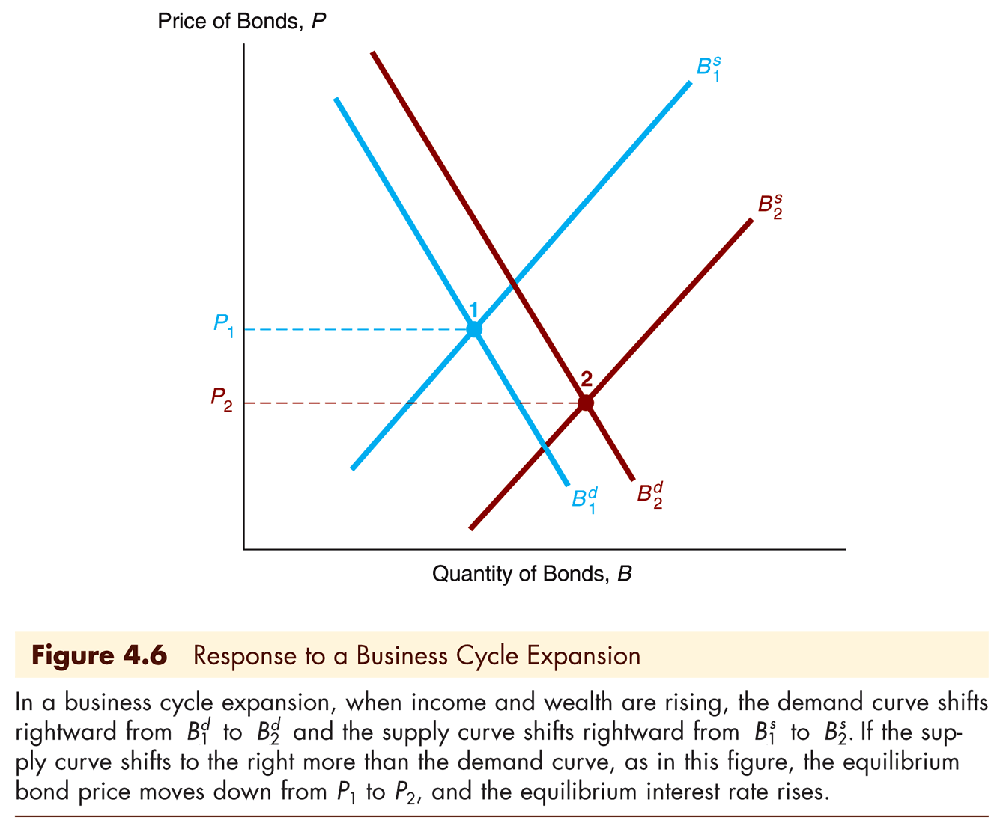
Business Cycle Expansion
Wealth ↑, B^{d} ↑, B^{d} shifts out to right
Investment ↑, B^{s} ↑, B^{s} shifts right
If B^{s} shifts more than B^{d} then P ↓, i ↑

Slide 62
Evidence on Business Cycles and Interest Rates

Slide 63
Case: Low Japanese Interest Rates
In November 1998, Japanese interest rates on six-month Treasury bills turned slightly negative. How can we explain that within the framework discussed so far?
It’s a little tricky, but we can do it!

Slide 64
Case: Low Japanese Interest Rates
Negative inflation lead to B^{d} ↑
B^{d} shifts out to right
Negative inflation lead to ↓ in real rates
B^{s} shifts out to left
Net effect was an increase in bond prices (falling interest rates).

Slide 65
Case: Low Japanese Interest Rates
Business cycle contraction lead to ↓ in interest rates
B^{s} shifts out to left
B^{d} shifts out to left
But the shift in B^{d} is less significant than the shift in B^{s}, so the net effect was also an increase in bond prices.

Slide 66
3. Risk structure of interest rate
Factors Affecting Risk Structure of Interest Rates.
Credit ratings
Risk Structure of Interest Rate

Slide 67
Risk Structure of Long Bonds in the U.S.

Slide 68
Risk Structure of Long Bonds in the U.S.
The figure show two important features of the interest-rate behavior of bonds.
Rates on different bond categories change from one year to the next.
Spreads on different bond categories change from one year to the next (The spread between the interest rate on Baa corporate bonds and U.S. government bonds is very large during the Great Depression)

Slide 69
Factors Affecting Risk Structure of Interest Rates
To further examine these features, we will look at three specific risk factors.
Default Risk
Liquidity
Income Tax Considerations

Slide 70
Default Risk Factor
Default risk: the issuer of the bond is unable or unwilling to make interest payments when promised.
U.S. Treasury bonds have usually been considered to have no default risk because the federal government can always increase taxes to pay off its obligations (or just print money) → Default-free bonds.
The spread between the interest rates on bonds with default risk and default-free bonds, called the risk premium.
A bond with default risk will always have a positive risk premium, and an increase in its default risk will raise the risk premium.

Slide 71
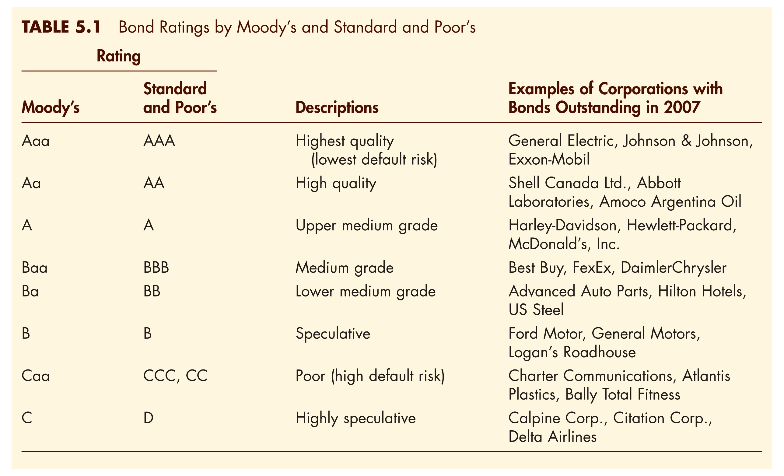
Bond Ratings

Slide 72
Credit Ratings
Credit ratings are aimed at reducing information asymmetries by providing information on the rated security
“ A firm’s credit rating reflects a rating agency’s opinion of an entity’s overall creditworthiness and its capacity to satisfy its financial obligations” (Standard & Poor’s, 2002).
The rating does not provide guidance on other aspects essential for investment decisions, such as market liquidity or price volatility → bonds with the same rating may have very different market prices.
Ratings are opinions and not recommendations to purchase, sell, or hold any security.
(Ref: Katz, Salinas, and Stephanou, Credit Rating Agencies, No Easy Regulatory Solutions )

Slide 73
Problem 5
What is the yield on a $1,000,000 municipal bond with a coupon rate of 8%, paying interest annually, versus the yield of a $1,000,000 corporate bond with a coupon rate of 10% paying interest annually? Assume that you are in the 25% tax bracket
Municipal bonds’ yield = coupon rate (because they are tax-exempt
Corporate bonds’ yield = 10%*(1-25%)=7.5%

Slide 74
Risk Structure of Interest Rate
Interest rate = Risk Free Rate
+ (Inflation Premium)
+ Default Risk Premium
+ Liquidity Risk Premium
+ (Maturity Risk Premium)
+ (Tax Discrepancy Premium)

Slide 75
4. Term structure of interest rate
Yield curve
Spot rates and forward rates.
Three Facts of the Term Structure of Interest Rates

Slide 77
Term structure of interest rate
The term structure of interest rates is the relation between different interest rates for different term-to-maturity loans.
If we observe r₁ = 8%,
r₂ = 9%, r₃ = 9.5%,
r₄ = 9.75% and
r₅ = 9.875% then the current term structure of interest rates is represented by plotting these “spot rates” against their terms-to-maturity.
The curve plotted through the above points is also called the “yield curve”

Slide 78
Spot Rates
The n-period current spot rate of interest denoted r_{n} is the current interest rate (fixed today) for a loan (where the cash is borrowed now) to be repaid in n periods.
Spot rates are only determined from the prices of zero-coupon bonds and are thus applicable for discounting cash flows that occur in a single time period.
This differs from the more broad concept of yield to maturity that is, in effect, an average rate used to discount all the cash flows of a level coupon bond.

Slide 79
Spot rate and YTM
Yield to maturity is just a complex, nonlinear “average” of spot rates of interest.
Because most of the bond’s cash flow arrives at maturity (the principal), the T-year spot rate gets the most weight in the yield-to-maturity calculation.
High coupon bonds pay a larger percentage of their face value as coupons than low coupon bonds; thus, their yields-to-maturity give more weight to earlier spot rates.

Slide 80
Forward Rates
The one-period forward rate of interest denoted f_{n} is the interest rate (fixed today) for a one period loan to be repaid at some future time period, n.
I.e., the money is borrowed in period n-1 and repaid in period n.
Investing $1,000 in the two year zero coupon bond @ r₂=9% gives $1,188.10 in 2 yrs. This is equivalent to investing in the one year bond at 8%, giving $1,080 after 1 year, and then investing in another 1 year bond @ X% for the second year to get $1,188.10.
Solve for X . . . the forward rate.

Slide 81
Forward Rates (continued)
To calculate a forward rate, the following equation is useful:
1 + f_{n} = (1+r_{n})^{n} / (1+r_{n-1})^{n-1}
where f_{n} is the one period forward rate for a loan repaid in period n
(i.e., borrowed in period n-1 and repaid in period n)
Calculate f₂ given r₁=8% and r₂=9%
Calculate f₃ given r₃=9.5%

Slide 82
Problem 6
You are given the following prices of US Treasury Strips (discount or zero coupon bonds):
a. Compute the spot rates for years 1, 2 and 3.
Maturity | Price (per 100 FV)
1 2 3 | 96.2 91.6 86.1

Slide 83
Problem 6 (cont.)
b.Now, suppose you are offered a project which returns the following cashflows:
$300m at the end of year 1,
$210m at the end of year 2,
$400m at the end of year 3,
The project costs $600m today.
Calculate the NPV of the project using the spot rates computed above.

Slide 84
Problem 7
Assume that spot interest rates are as follows:
Compute the prices and YTMs of the following bonds:
- A zero-coupon bond with 3 years to maturity.
- A bond with coupon rate 5% and 2 years to maturity.
- A bond with coupon rate 6% and 4 years to maturity.
* Assume that spot rates and YTMs are with annual compounding, coupon payments are annual, and par values are $100.
Maturity (year) | Spot rates (%)
1 2 3 4 | 3.0 3.5 4.0 4.5

Slide 85
Term Structure of Interest Rates
Bonds with identical risk, liquidity, and tax characteristics may have different interest rates because the time remaining to maturity is different
Yield curve—a plot of the yield on bonds (spot rates) with differing terms to maturity but the same risk, liquidity and tax considerations
Upward-sloping : long-term rates are above short-term rates
Flat: short- and long-term rates are the same
Inverted: long-term rates are below short-term rates

Slide 86
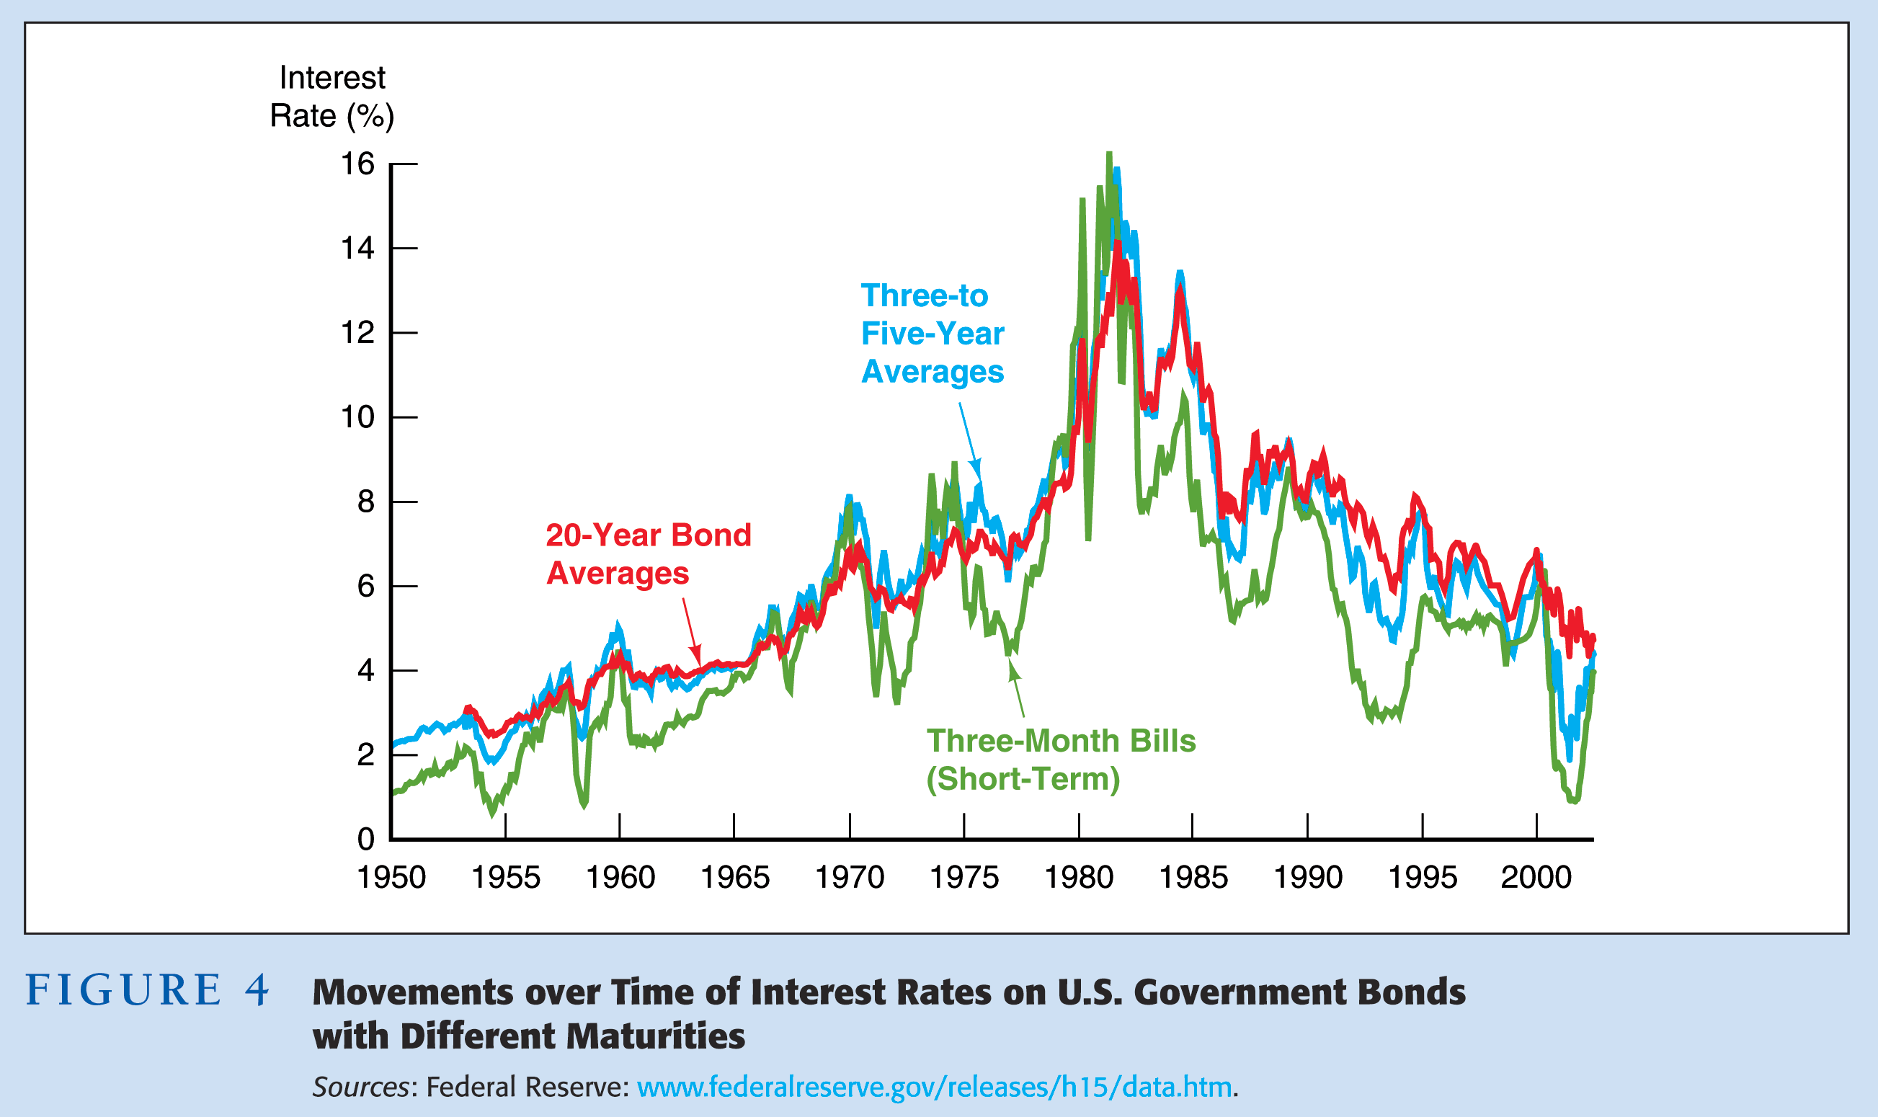

Slide 87
Facts Theory of the Term Structure of Interest Rates Must Explain
Interest rates on bonds of different maturities move together over time
When short-term interest rates are low, yield curves are more likely to have an upward slope; when short-term rates are high, yield curves are more likely to slope downward and be inverted
Yield curves almost always slope upward

Slide 88
Three Theories to Explain the Three Facts
Expectations theory explains the first two facts but not the third
Segmented markets theory explains fact three but not the first two
Liquidity premium theory combines the two theories to explain all three facts

Slide 89
Expectations Theory
The interest rate on a long-term bond will equal an average of the short-term interest rates that people expect to occur over the life of the long-term bond
Buyers of bonds do not prefer bonds of one maturity over another; they will not hold any quantity of a bond if its expected return is less than that of another bond with a different maturity
Bonds like these are said to be perfect substitutes

Slide 90
Expectations Theory—Example
Let the current rate on one-year bond be 6%.
You expect the interest rate on a one-year bond to be 8% next year.
Then the expected return for buying two one-year bonds averages (6% + 8%)/2 = 7%.
The interest rate on a two-year bond must be 7% for you to be willing to purchase it.

Slide 91
Expectations Theory—In General

Slide 92
Expectations Theory—In General (cont’d)

Slide 93
Expectations Theory—In General (cont’d)

Slide 94
Expectations Theory—In General (cont’d)

Slide 95
Expectations Theory
Explains why the term structure of interest rates changes at different times
Explains why interest rates on bonds with different maturities move together over time (fact 1)
Explains why yield curves tend to slope up when short-term rates are low and slope down when short-term rates are high (fact 2)
Cannot explain why yield curves usually slope upward (fact 3)

Slide 96
Segmented Markets Theory
Bonds of different maturities are not substitutes at all
The interest rate for each bond with a different maturity is determined by the demand for and supply of that bond
Investors have preferences for bonds of one maturity over another
If investors have short desired holding periods and generally prefer bonds with shorter maturities that have less interest-rate risk, then this explains why yield curves usually slope upward (fact 3)

Slide 97
Liquidity Premium & Preferred Habitat Theories
The interest rate on a long-term bond will equal an average of short-term interest rates expected to occur over the life of the long-term bond plus a liquidity premium that responds to supply and demand conditions for that bond
Bonds of different maturities are substitutes but not perfect substitutes

Slide 98
Liquidity Premium Theory

Slide 99
Preferred Habitat Theory
Investors have a preference for bonds of one maturity over another
They will be willing to buy bonds of different maturities only if they earn a somewhat higher expected return
Investors are likely to prefer short-term bonds over longer-term bonds

Slide 100
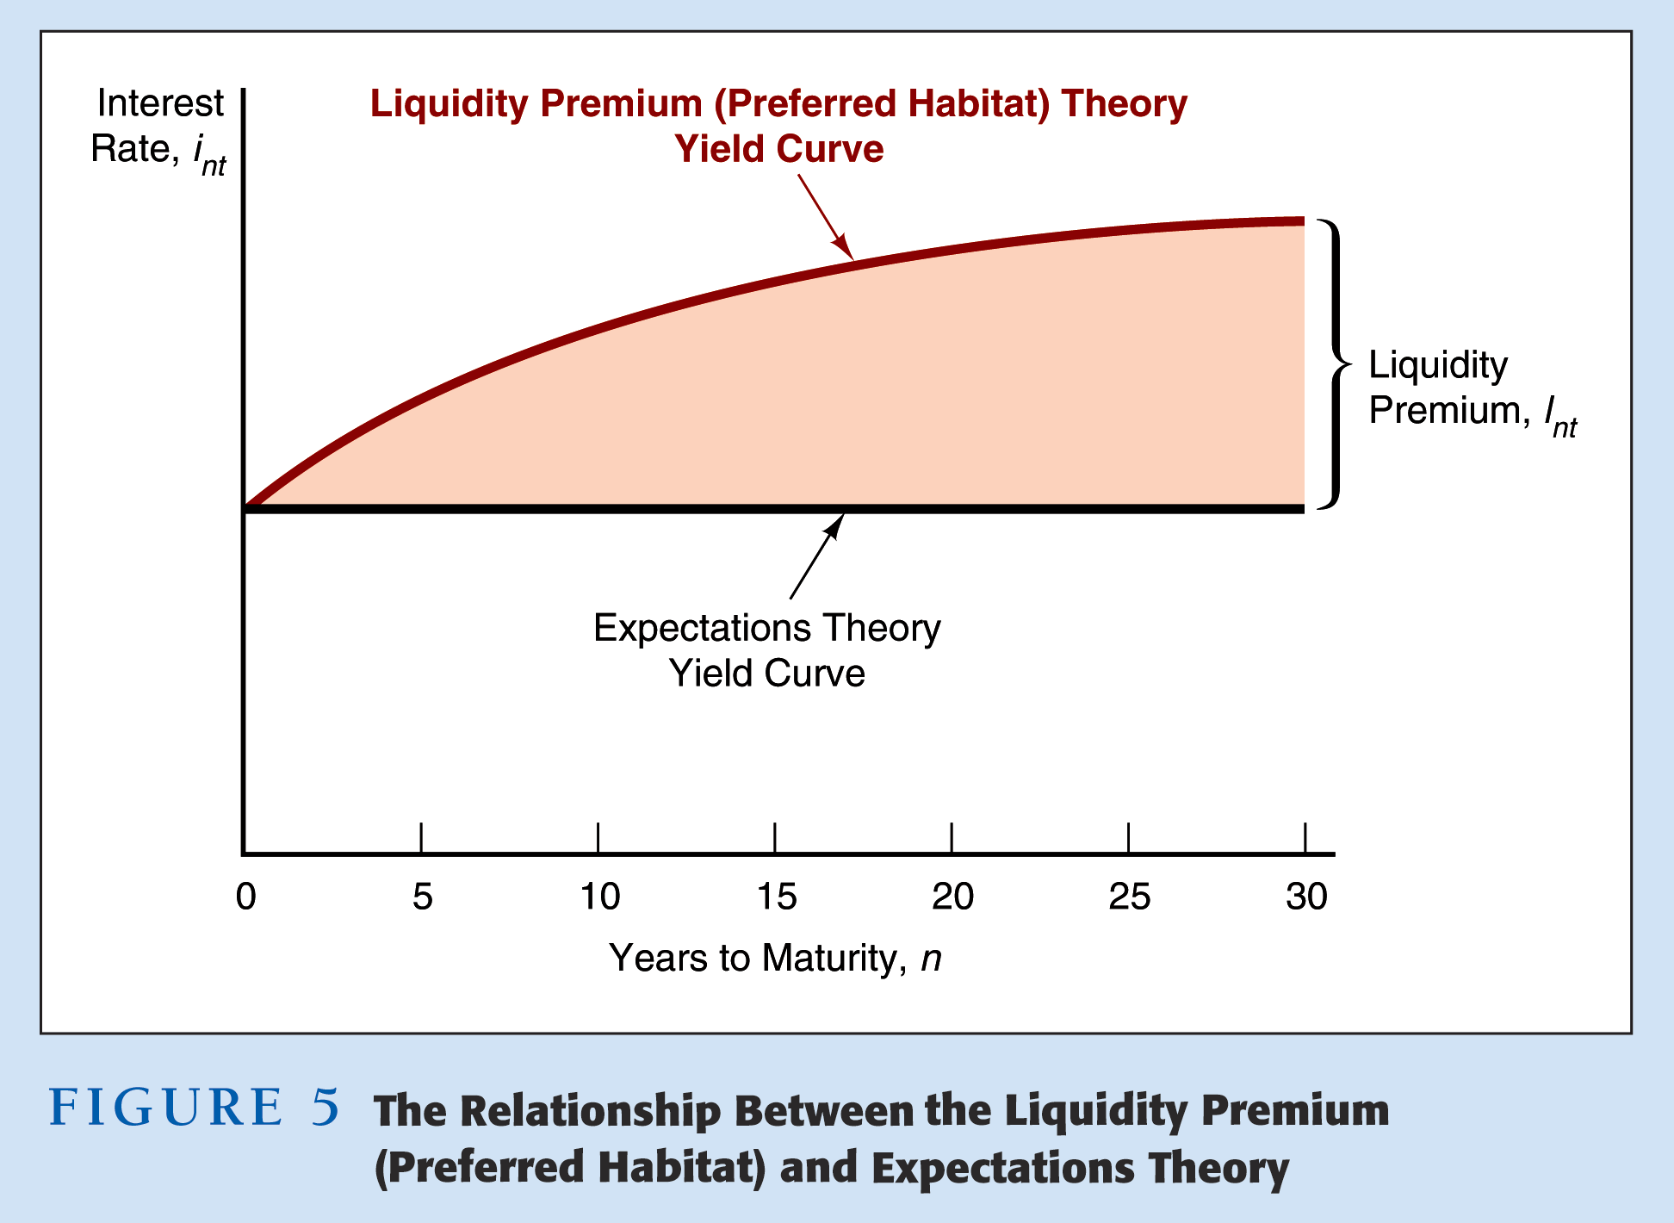

Slide 101
Liquidity Premium and Preferred Habitat Theories, Explanation of the Facts
Interest rates on different maturity bonds move together over time; explained by the first term in the equation
Yield curves tend to slope upward when short-term rates are low and to be inverted when short-term rates are high; explained by the liquidity premium term in the first case and by a low expected average in the second case
Yield curves typically slope upward; explained by a larger liquidity premium as the term to maturity lengthens

Slide 102
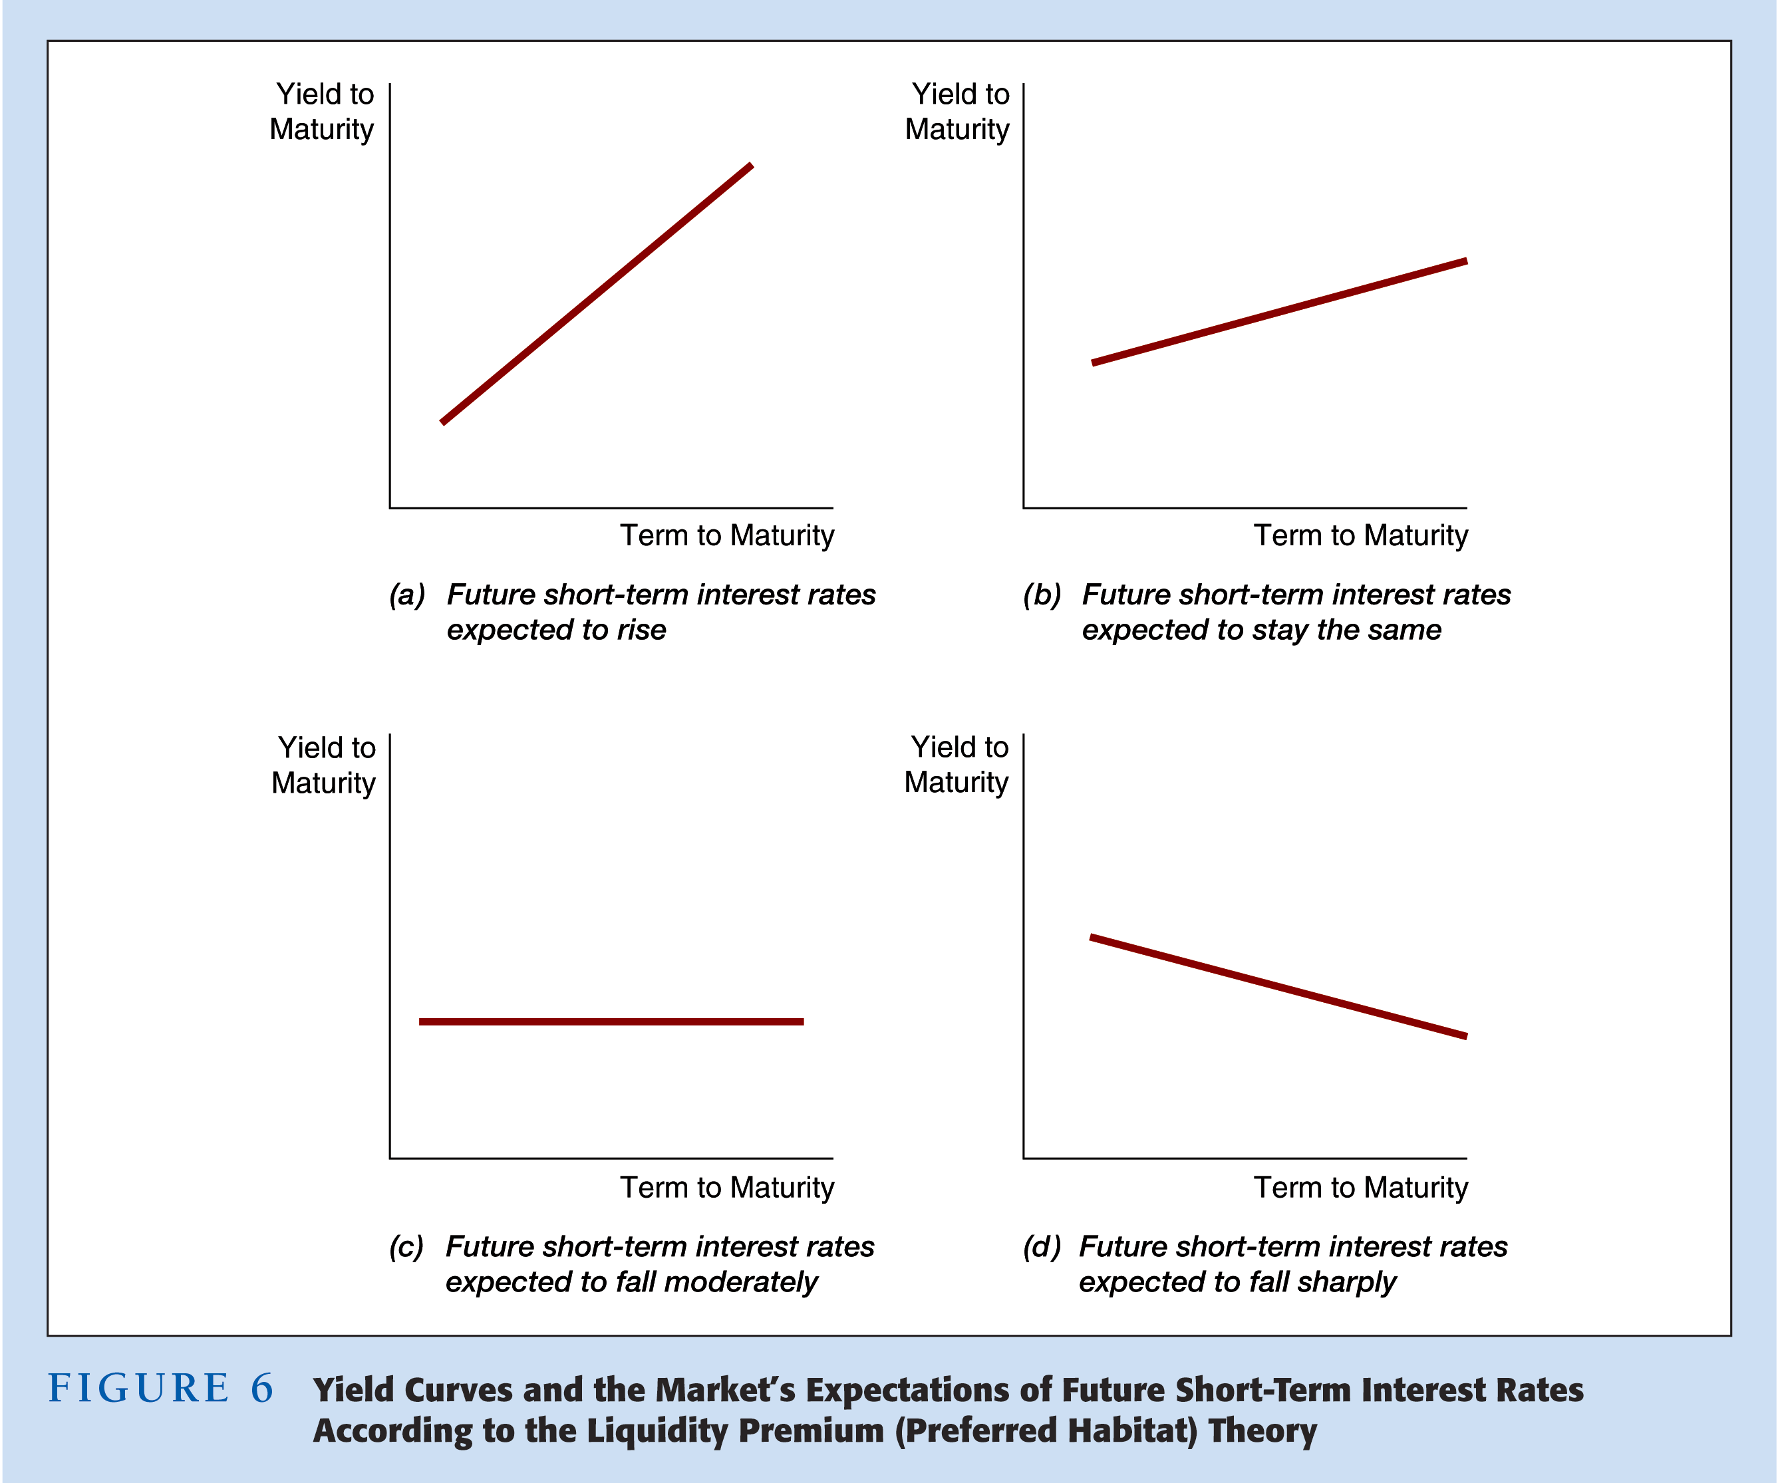

Slide 103
A Closer Look at the Term Structure
Uses of the term structure
Forecast interest rates
Pure expectations and liquidity premium theories can be used
Forecast recessions
A flat or inverted yield curve may indicate a recession in the near future since lower interest rates are expected

Slide 104
A Closer Look at the Term Structure (cont’d)
Uses of the term structure (cont’d)
Investment decisions
Riding the yield curve involves investment in higher-yielding long-term securities with short-term funds
Financial institutions whose liability maturities are different from their asset maturities monitor the yield curve
Financing decisions
Assessing prevailing rates on securities for various maturities allows firms to estimate the rates to be paid on bonds with different maturities

Slide 105
A Closer Look at the Term Structure (cont’d)
Impact of debt management on term structure
If the Treasury uses a relatively large proportion of long-term debt, this places upward pressure on long-term yields
If the Treasury uses short-term debt, long-term interest rates may be relatively low
Historical review of the term structure
Early 1980s: downward sloping yield curve
1982 to 2001: an upward sloping yield curve generally persisted
September 11, 2001: investors shifted funds into short-term securities and the Fed provided funds to the banking system, causing the yield curve to become steeper

Slide 106
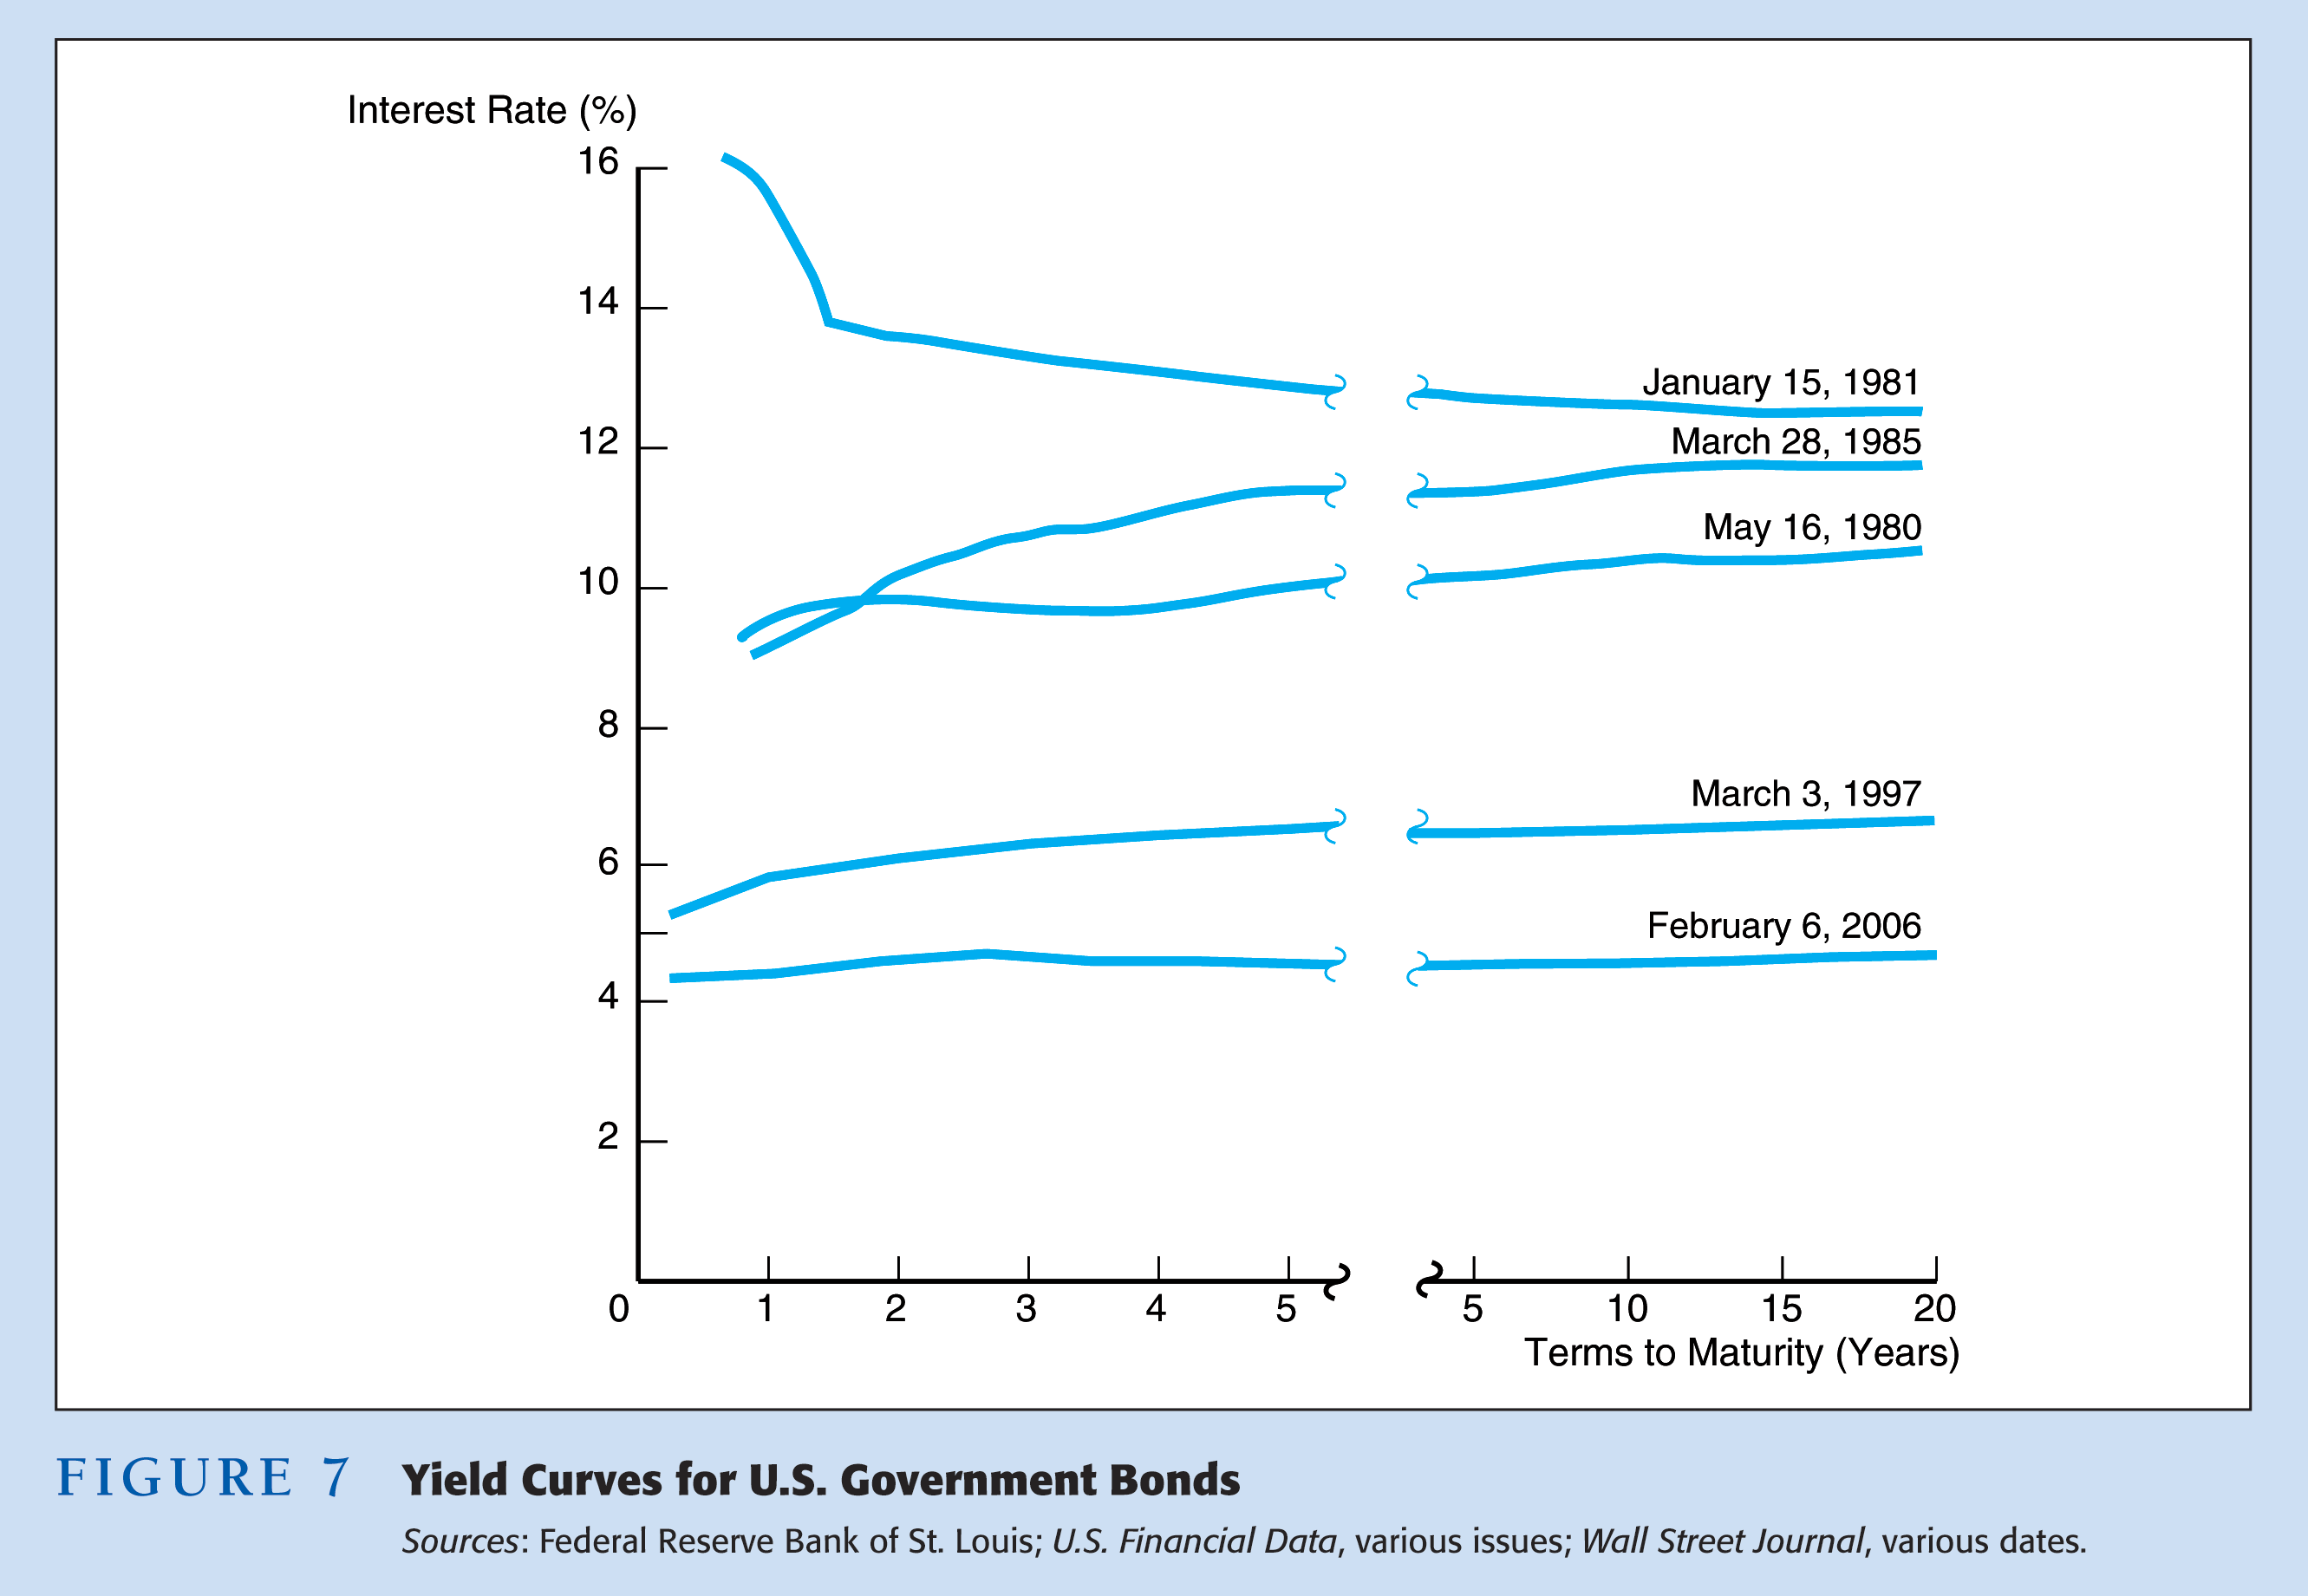

Slide 107
Problem 8
If the interest rates on one-to five-year bonds are currently 4%, 5%, 6%, 7% and 8% and the term premium for one-to five bonds are 0%, 0.25%, 0.35%, 0.40% and 0.50%, predict what the one-year interest rate will be two years from now?

Slide 109
Reading materials
Michael D. Bauer and Thomas M. Mertens (2018); “Information in the Yield Curve about Future Recessions”, Working paper
2. De Backer, B., Deroose, M., & Nieuwenhuyze, C. V. (2019). Is a recession imminent? The signal of the yield curve. Economic Review, (i), 69-93.

Slide 110
Yield curve and recession
Michael D. Bauer and Thomas M. Mertens (2018); “Information in the Yield Curve about Future Recessions”, Working paper
De Backer, B., Deroose, M., & Nieuwenhuyze, C. V. (2019). Is a recession imminent? The signal of the yield curve. Economic Review, (i), 69-93.
Is inverted yield curve is a recession imminent? Why? Explain the impact of a flatter or negative curve on banks’ profitability. Find the answer with the following papers.
Explainer: U.S. yield curve inverts again: What is it telling us? https://www.reuters.com/markets/us/us-yield-curve-inverts-again-what-is-it-telling-us-2022-07-05/
Joe Rennison (2022) Another Closely Watched Recession Alarm Is Ringing https://www.nytimes.com/2022/10/26/business/yield-curve-inversion-recession.html
https://www.youtube.com/watch?v=bItazfbSptI

Slide 111
NEGATIVE INTEREST RATES
Watch the following documentary (DW: How the rich become richer – money in the world economy). Read the supplementary materials (Larosiere, Pitkanen, Rajan, Rennison). Summarize the negative effects of very low/negative interest rates.
https://youtu.be/t6m49vNjEGs
Another documentary to see
https://youtu.be/FiYTmTHFa9E

Slide 112
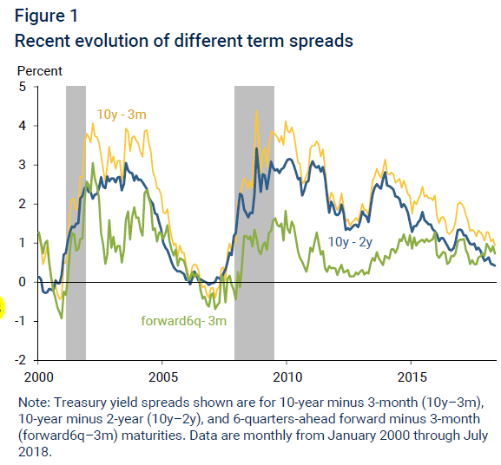
Ref: Michael D. Bauer and Thomas M. Mertens (2018); “Information in the Yield Curve about Future Recessions”, Working paper

Slide 113
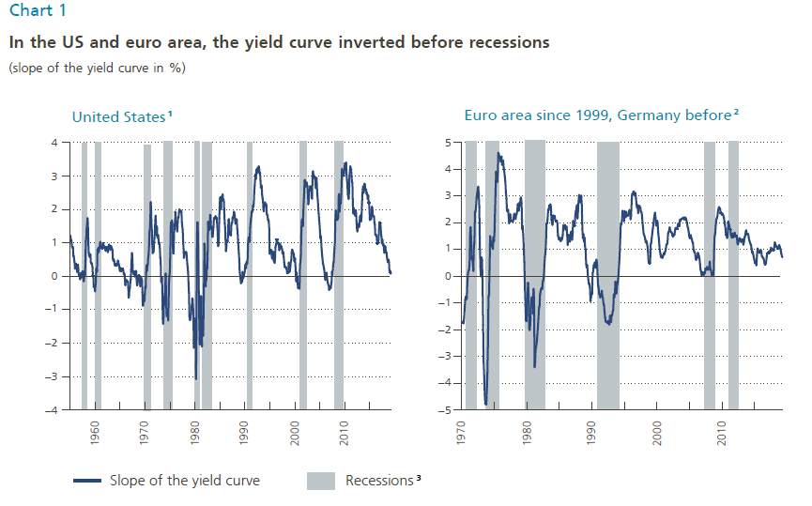
Ref: B. De Backer M. Deroose, Ch. Van Nieuwenhuyze (2019); “Is a recession imminent ? The signal of the yield curve”, Working paper

Slide 114
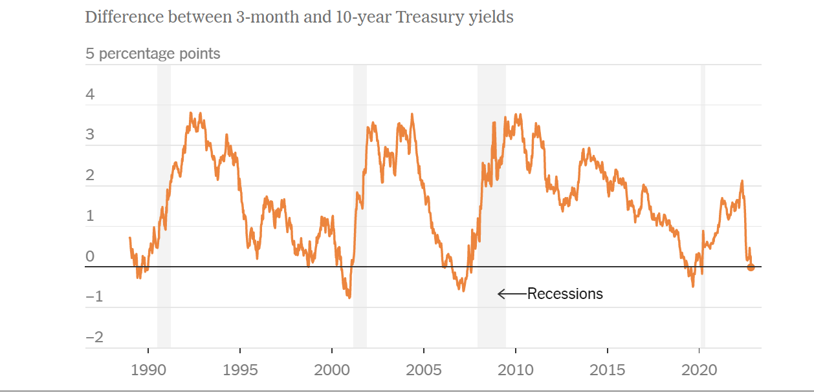
As of Oct. 26, 2022 By The New York Times

Slide 115
How does raising interest rates control inflation?
https://www.youtube.com/watch?v=R8VBRCs2jTU

Slide 116
THE END OF CHAPTER 2

